Slide 1
CHAPTER 1. MAMMALIAN HISTOLOGY
T.Y.B.Sc. ZOOLOGY
SEMESTER V COURSE XIII
Histology, Pathology, Toxicology and Biostatistics
This video is for education purpose only no copyright infringement. The copyright belongs to its rightful owner. The credit goes to respective artists, designers, video music composers and singers.

Slide 2
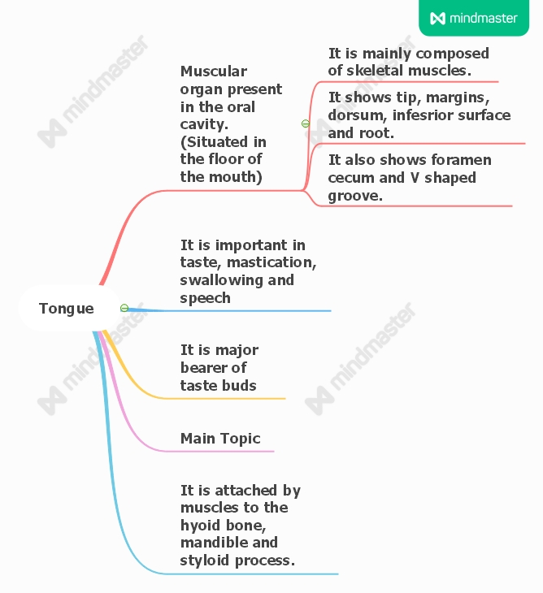

Slide 3
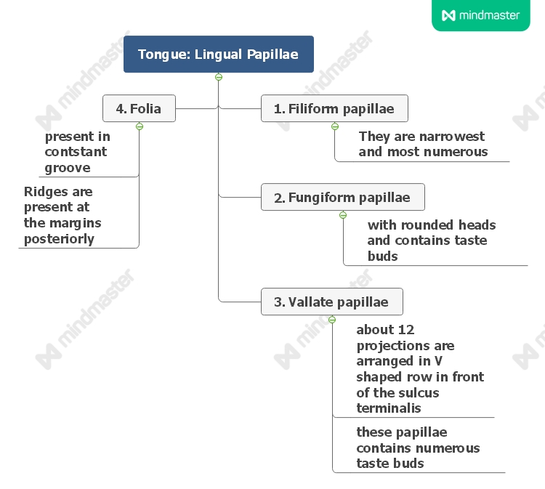

Slide 4
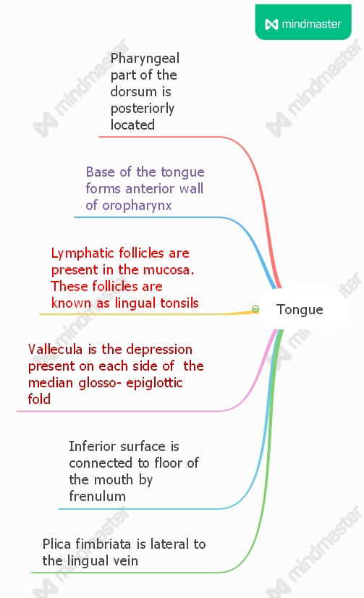

Slide 5
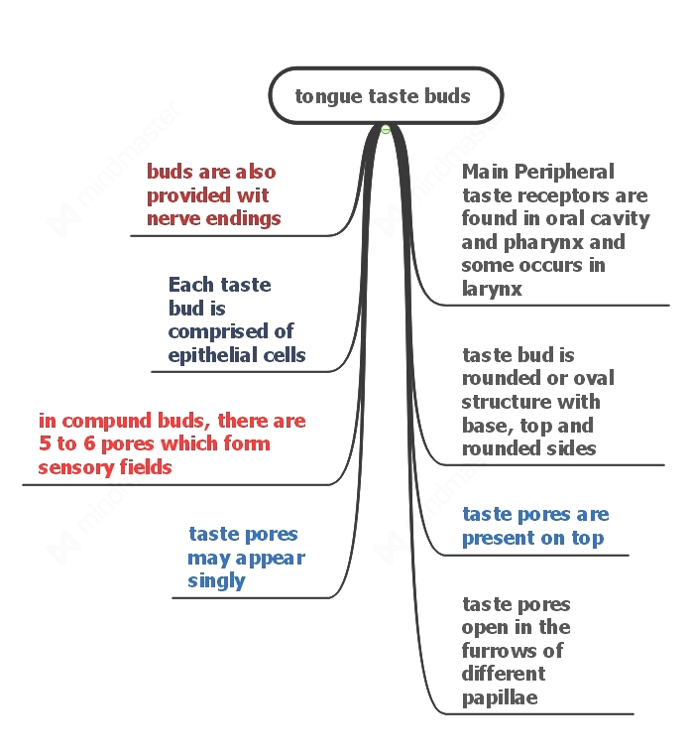

Slide 7
THANK YOU

